Slide 1

Capstone Project Planning
GROUP: G5
Topic: Coffee Shop Website

Slide 2
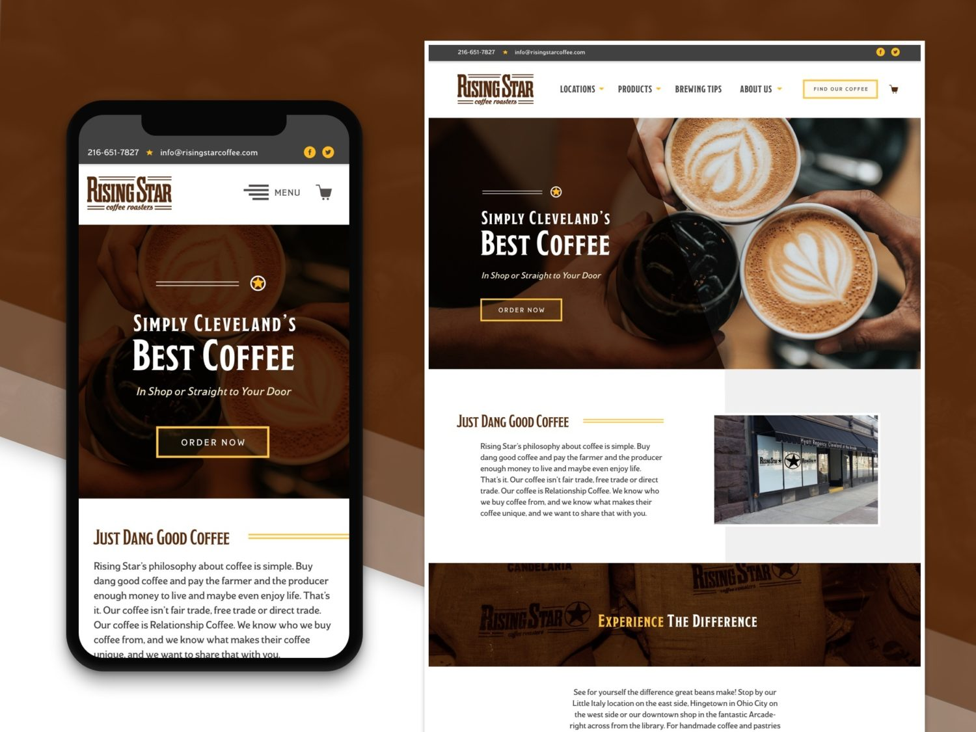
Introduction- Getting Started….
Drinking coffee on daily basis is way of life in todays world. This is precisely we choose to develop coffee website through this project.
We planned to make the contents and the GUI of this project user friendly, that means anyone can comfortably use website.
We collected the basic technical as well as non-technical information regarding this topic that will help us to build the project.
This project is divided in two parts:
Part 1- Planning of the Project.
Part 2- Execution of the Project.

Slide 3


Languages to be Used.
As mentioned this project is web-based, so we decided to develop this project using HTML, JAVASCRIPT using Client-Side Operations.
Languages to be used:
HTML
HTML is (hyper text markup language) the code that is used to structure a webpage and its content.
JAVASCRIPT
JavaScript s text based programming language used both on client side and server side that allows you to make webpages interactive.

Slide 4
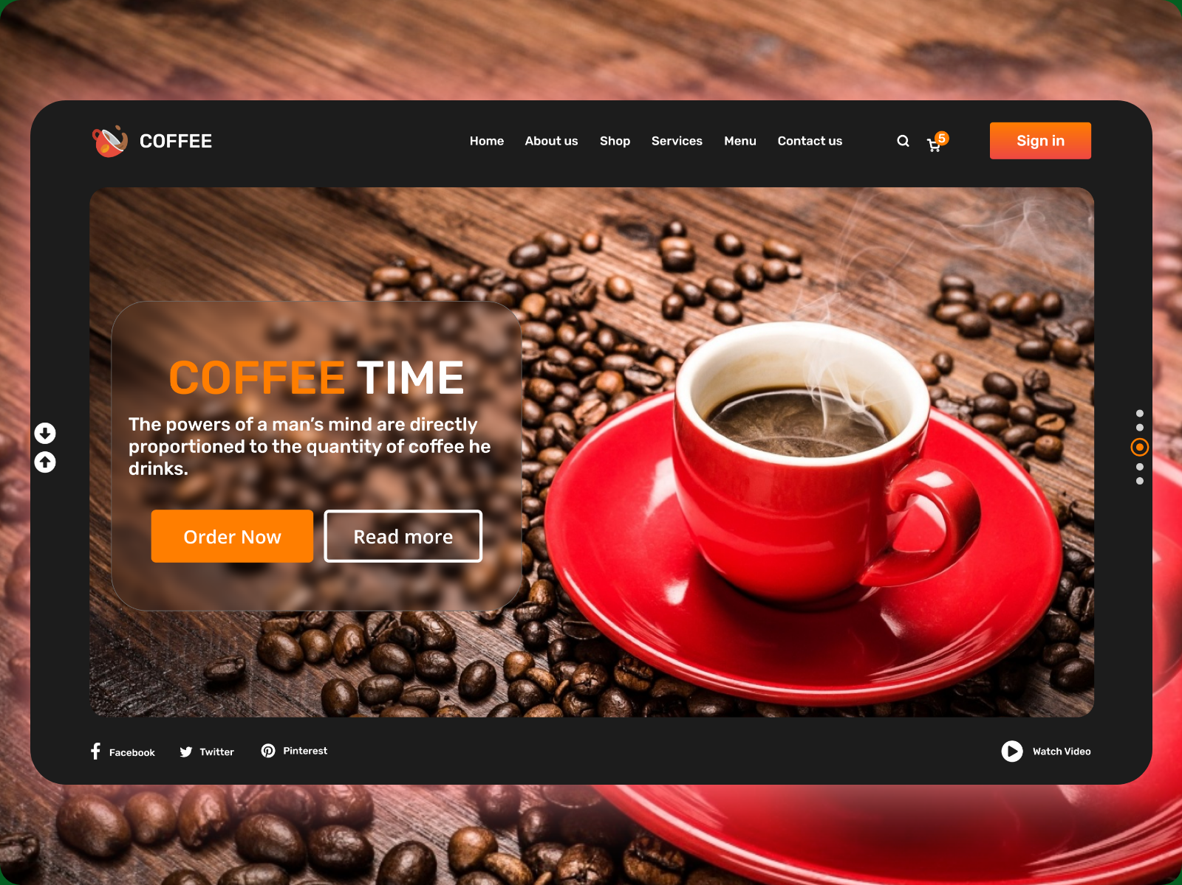
Advantages of the Project
Interactive Experience
Saves time and efforts
Get detailed information about the product.
User Friendly
Easy Shipping
Interactive Interface
Keep Records of the Order
Interactive Webpage

Slide 5


Disadvantages of the Project
Chances of Technical Problems in the System.
Mismatch data of orders, customers and orders.
Requires Internet Connection.

Slide 6
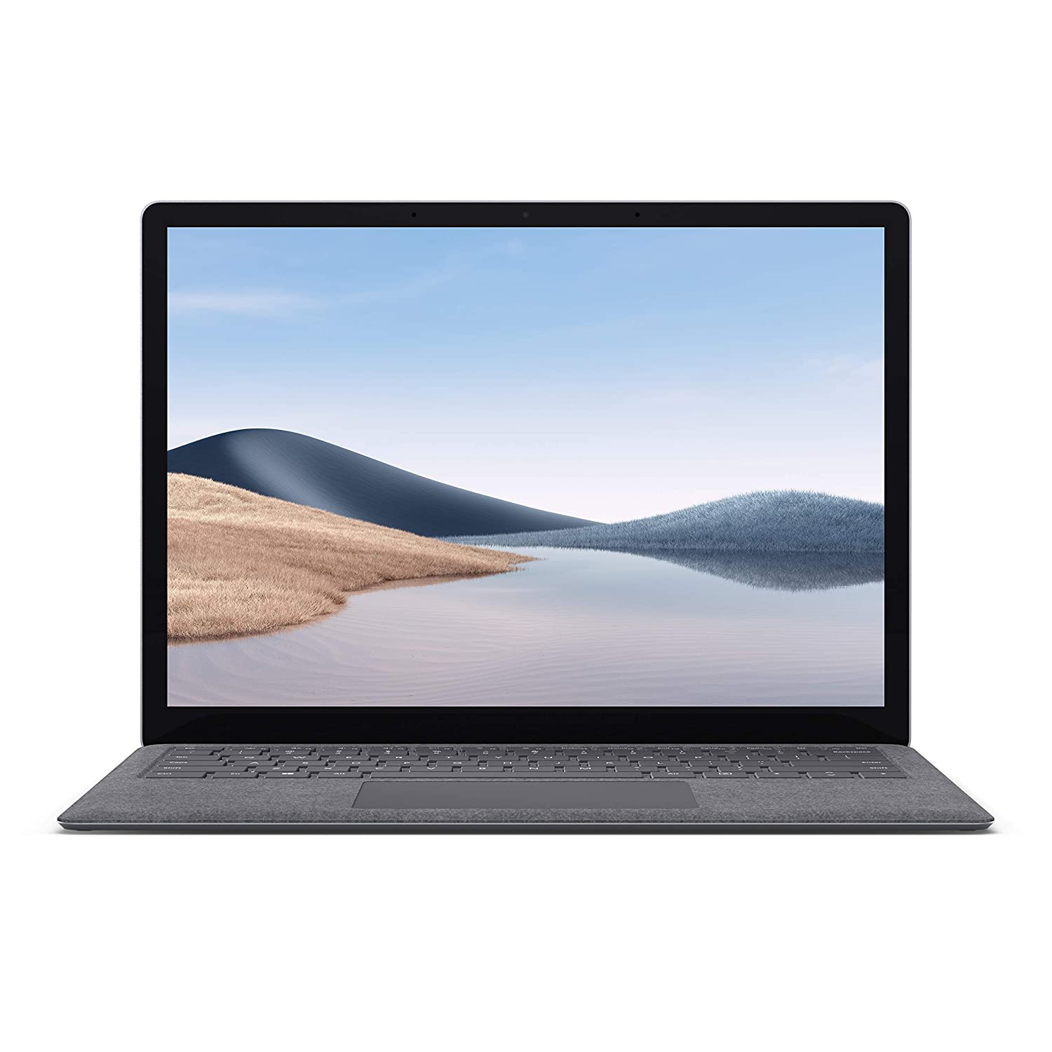

Software and Hardware Requirements.
Software Requirements
Code languages: HTML, JAVASCRIPT
Text Editor: Notepad++ and Visual Code Studio
Browser: Google Chrome or Mozilla Firefox
Hardware Requirements
System: Laptop
Processor: Intel i3
Ram: 4GB
Windows 10 Home 64-Bit

Slide 7
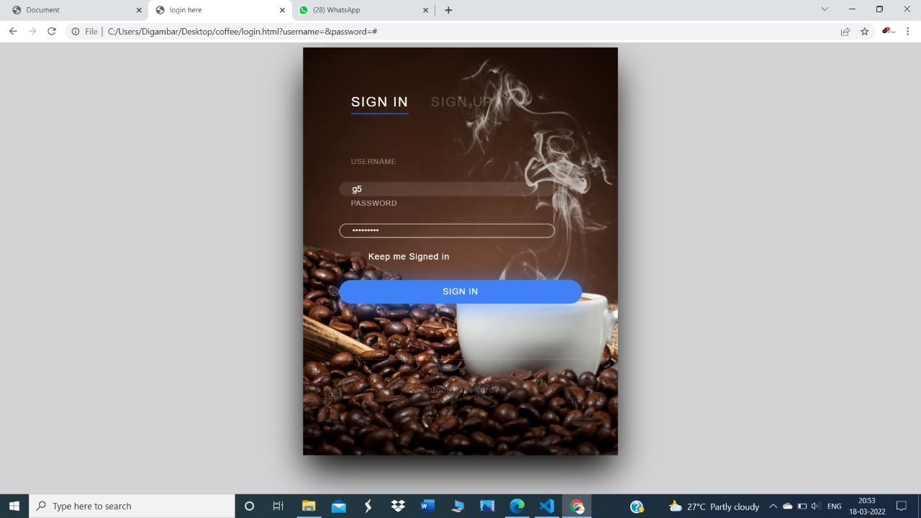
Project Screenshots Login Page

Slide 8
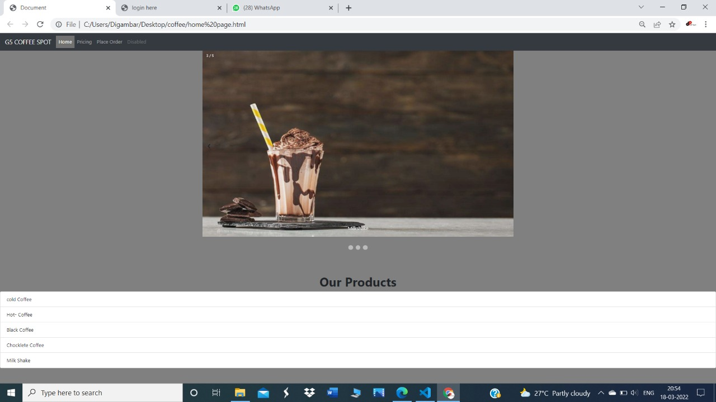
Main Page

Slide 9
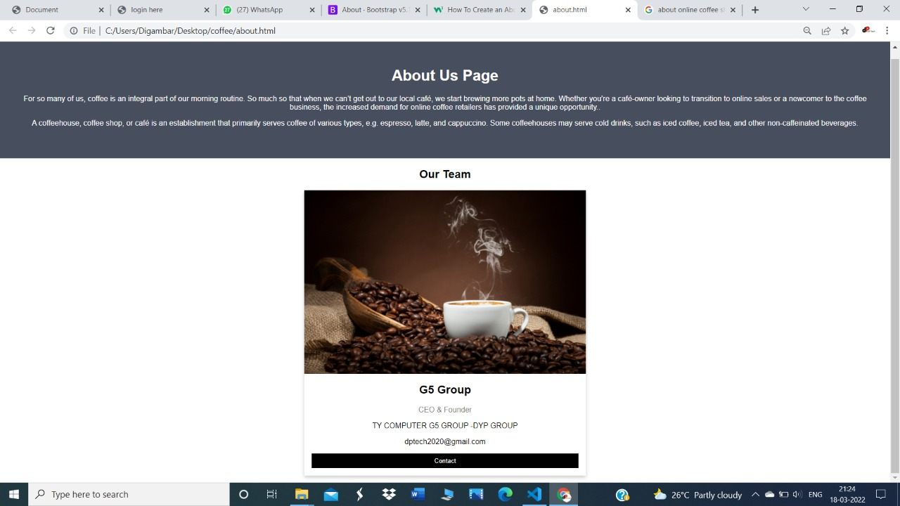
About us

Slide 10
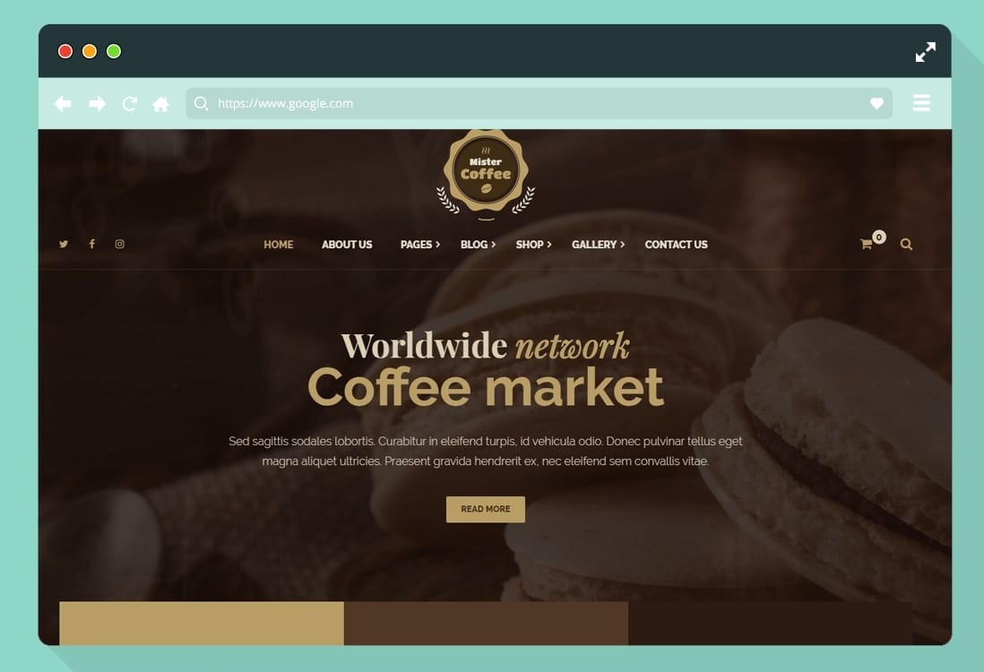

Conclusion
Here we are going to design a coffee website by using html and JavaScript that will contain all the elements of a standard website and can be available for both user(employee) and customer. Customers can view and order their favorite coffee from our website and they will also get a conformation message via email.
With Coffee Shop Website we can enrichen the customer experience by making the process of ‘placing orders’ a lot easier. It will show the value of your customer’s time. Online ordering will guarantee a ‘level up’ to your web presence. And a good web presence will make you stand out in the search engine rankings and bring more customers to you.

Slide 11

Thank You
Presented by G5 group
.

